Slide 1


MODULE FIVE
DATABASE SECURITY AND DBA
DATE:

Slide 2

Objective
Overview of database security, including the key threats to database systems
Control measures and security mechanisms
role and responsibilities of database administrators in managing and securing databases
Backup and recovery

Slide 3
What is Database security?
Database security is the mechanisms that protect the database against intentional or accidental threats.
A threat means any situation or event whether intentional or accidental that may adversely affect the organization.

Slide 4
Threats to Databases
Loss of integrity
Database integrity refers to the requirement that information be protected from improper modification.
Loss of availability
Database availability refers to making objects available to a human user or a program to which they have a legitimate right.
Loss of confidentiality
Database confidentiality refers to the protection of data from unauthorized disclosure.
The objective of database security is to secure sensitive data and maintain the confidentiality, availability, and integrity of the database.

Slide 5
Types of database security
Network security
Access management
Threat protection
Information protection

Slide 6
Access Management
This involves controlling who can access the database and what they can do with it.
Authentication is the process of proving the user is who he or she claims to be by entering the correct user ID and password.
Authorization allows each user to access certain data objects and perform certain database operations like read but not modify data, modify but not delete data, or delete data.
Access control is managed by the system administrator who assigns permissions to a user within a database.

Slide 7
Database Audits
DBA Reviewing the system log to examine all accesses and operations applied to the database during a certain time period.
When an illegal or unauthorized operation is found, the DBA can determine the account number used to perform the operation.
Database audits are particularly important for sensitive databases that are updated by many transactions and users, such as a banking database which is updated by many bank tellers.
A database log that is used mainly for security purposes is sometimes called an audit trail.

Slide 8
Data Encryption
It is used to protect sensitive data (such as credit card numbers) that is being transmitted via some type communication network.
The data is encoded using some encoding algorithm.
An unauthorized user who access encoded data will have difficulty deciphering it, but authorized users are given decoding or decrypting algorithms (or keys) to decipher data.

Slide 9
Database Administrator
The database administrator (DBA) is the central authority for managing a database system.
The DBA is responsible for the overall security of the database system.
The DBA has a DBA account in the DBMS, sometimes called a system or super user account, which provides powerful capabilities that are not made available to regular database accounts and users.

Slide 10
Database Administrator
DBA-privileged commands include commands for performing the following types of actions:
Action 1: Account creation. This action creates a new account and password for a user or a group of users to enable access to the DBMS.
Action 2: Privilege granting. This action permits the DBA to grant certain privileges to certain accounts.
Action 3: Privilege revocation. This action permits the DBA to revoke (cancel) certain privileges that were previously given to certain accounts.
Action 4: Security level assignment. This action consists of assigning user accounts to the appropriate security clearance level.

Slide 11
Role and Responsibilities
Access Control and User Privileges
Data Encryption and Masking
Regular Monitoring and Auditing
Patch Management and Software Updates
Disaster Recovery and Backup Strategy

Slide 12
Backup and Recovery
Backup and recovery is the process of duplicating data and storing it in a secure place in case of loss or damage, and then restoring that data to a location.
Backup and recovery are essential components of database administration, ensuring the protection and restoration of data in the event of system failures, data corruption, or other unexpected incidents.

Slide 13
Why is it Important?
Hardware failure
Software malfunction
Accidental deletion
Cyberattacks
Natural disasters
With recovered data, you can minimize downtime, avoid wasting time recreating lost information, and ensure business continuity.

Slide 14
Backup
Backing up involves creating copies of your data and storing them elsewhere.
Recovery
Recovery is the process of retrieving your backed-up data and restoring it to its original location.

Slide 15
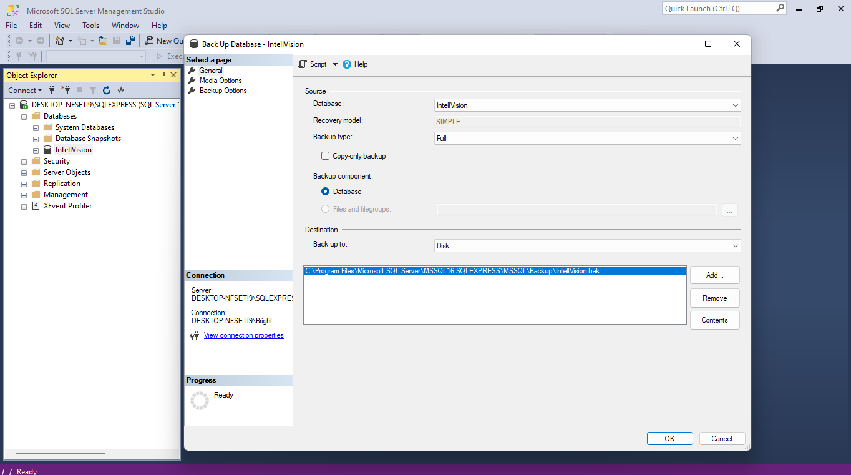
backups
Right click on the Database >> Task >> Backup

Slide 16
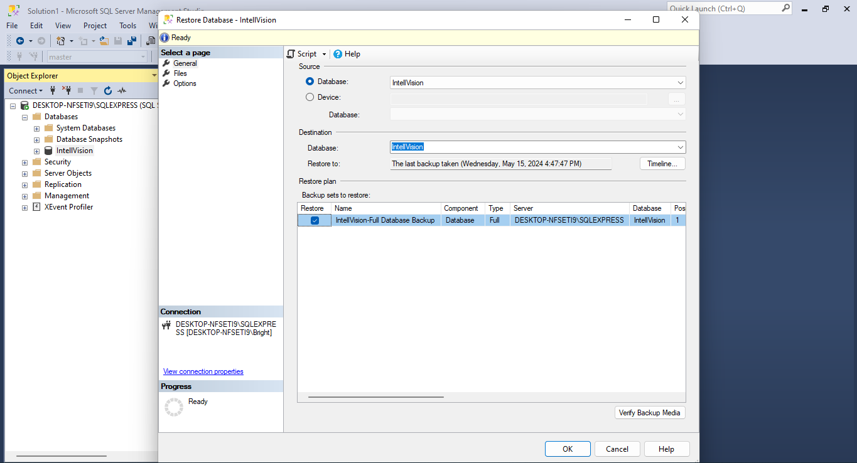
Recovery

Slide 17

Question and Answer

